Slide 1
Predicting Home Loan Approval
Syaerul Rochman

Slide 2
Table of Contents
Business Background and Objective | To Optimize Home Loan Approval and get more Efficient for getting a new client
Data Preparation | What’s columns in this dataset, how many categorical and numerical column?
Exploratory Data Analysis | Analyse the Data and Deep Dive
Feature Engineering | Change some Column to being more readable and prepare for ML
Modeling and Evaluation | Choose Model and Evaluate the Metrics Score
Conclusion and Recommendation | Conclusion and Business Recomendation

Slide 3
01
Business Understanding

Slide 4
Introduction
Every person in this world need home,but not all of them can’t afford one.
That’s why some Government try to provide a Home Loan, but there’s another problem, Government or another Third Party usually collaborate with Bank to provide the money for Home Loan or Home Loan itself.
Bank as the party in charge, have to know, what kind of client that can pay for Home Loans.

Slide 5
Business Problem
Does Marital Status affect the approval of Loan?
Sometimes, marital status is so important for some parties, such as when applying for a job, there is a qualification that the applicant is willing not to get married within a certain period of time, we want to see if there is any connection to this in a home loan?
How much minimum Income to be approved in Home Loan?
To repay loan we need some amount of money , but before repay we must qualified for a loan first, so how much minimum Income to be considered “Qualified” ?
What is the client’s favorite Residential Area?
Determining the area of the house is very important, because this relates to the price of the house, the distance from the workplace and the environmental atmosphere desired by the client

Slide 6
02
Data Preparation

Slide 7
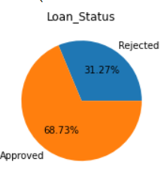
Overview
This data contains 641 rows and 12 features with “Loan Status” being Accepted or being rejected as a target.
Features consist 7 categorical features, and 5 numerical data features.
Numerical Features | Categorical Features
Applicant Income Co Applicant Income Loan Amount Loan Amount Term Credit History | Loan ID Gender Married Dependents Education Self Employed Residential Area Loan Status
Target distribution is Imbalance, I will use Precision-Recall as model metric Evaluation

Slide 8
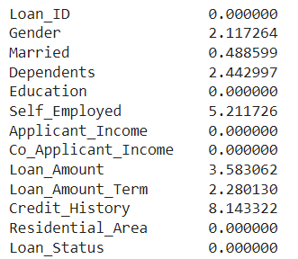
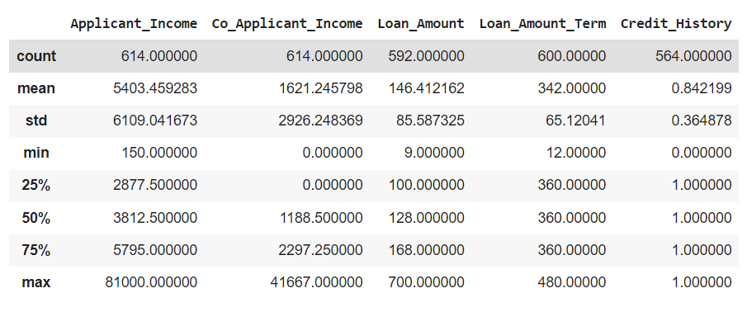
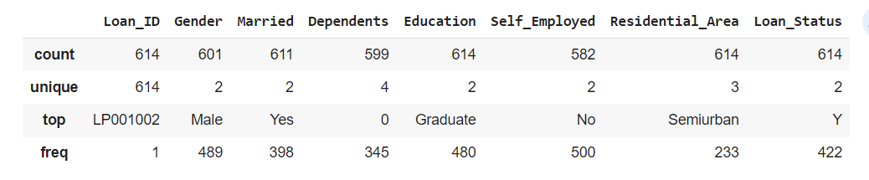
Missing Value Handling
Fill Missing Values by Mode if the column Contains “2 data” only like Married (Yes/No) and Fill Missing Values by Median if data contains Outlier
Loan ID = Count so we will drop these feature later.

Slide 9
03
Exploratory Data Analysis

Slide 10
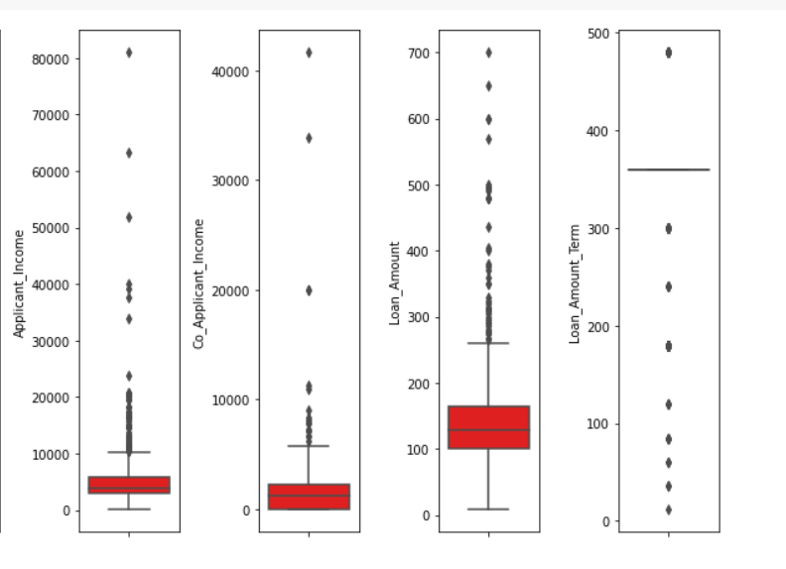
Outlier Detection
4 Features have Extreme Outlier and will be handle by using (Upper Limit and Lower Limit) also some “Common Sense” based on Interquartile Range (IQR)

Slide 11
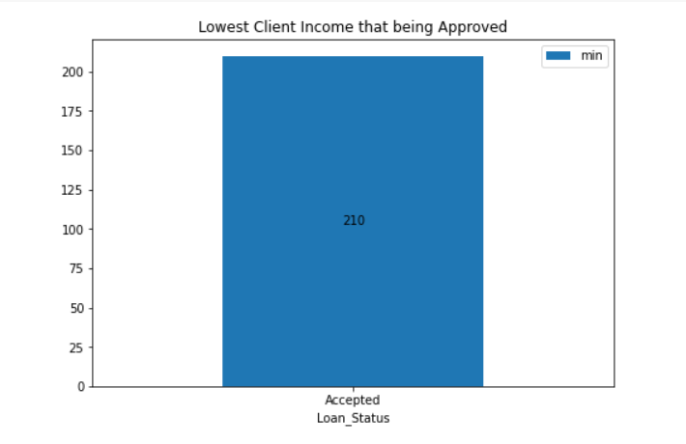
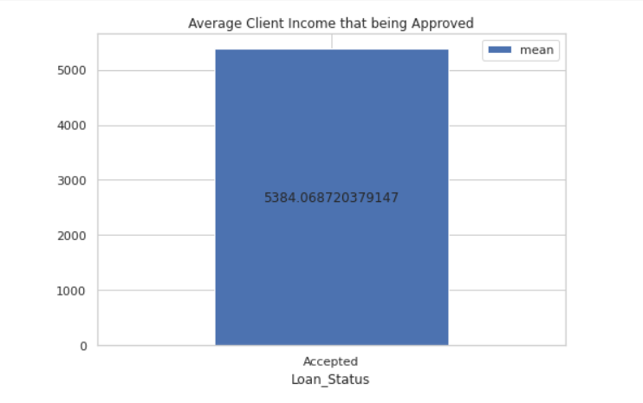
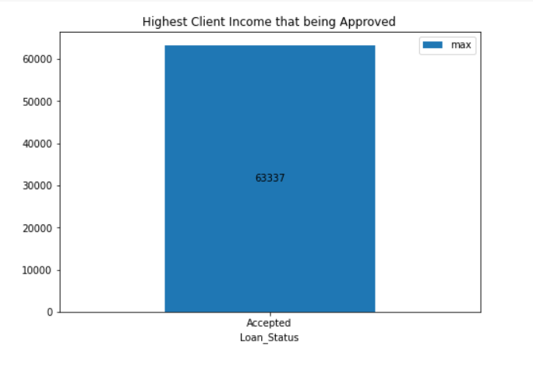
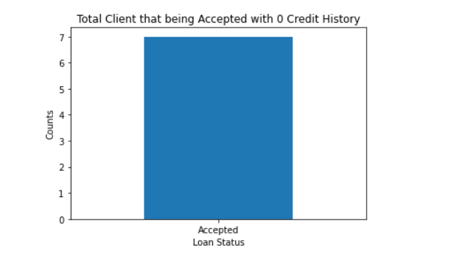
Question
1. How much lowest and highest, and average income to being Accepted in Home Loan?
2. Does there any client that have no credit history (credit history = 0) that being accepted in Home Loan?

Slide 12
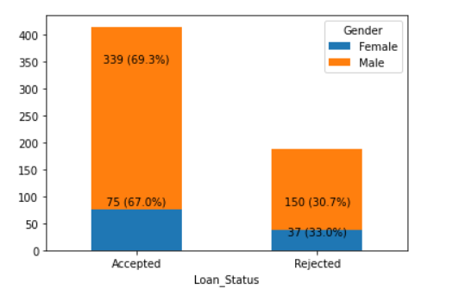
Compare Main Categorical Data with Target
Gender, whether male or female, is proven not to affect Home Loan approval,
because the percentage (%) difference is very small

Slide 13
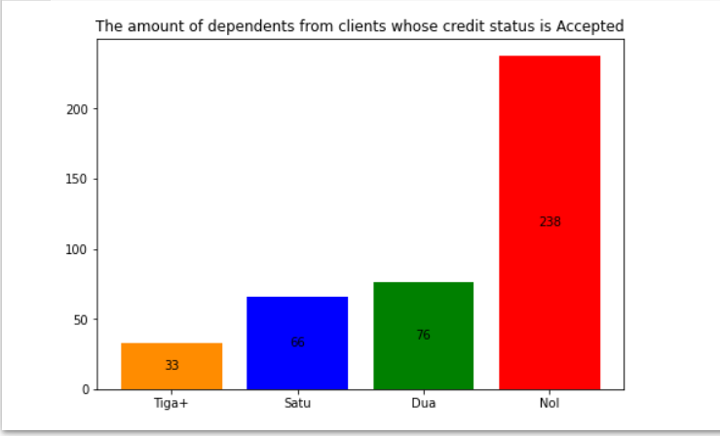
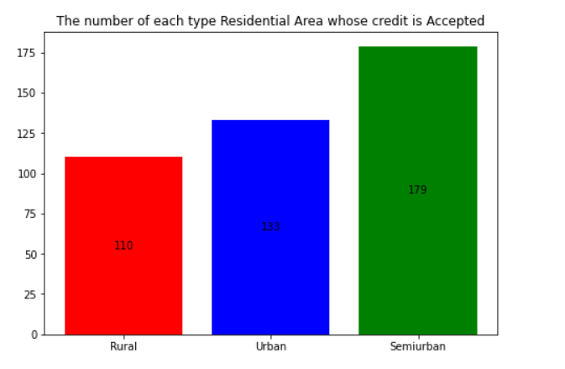
Compare Main Categorical Data with Target
Less dependents the client have = more higher chance their Home Loan being Accepted
Favorite Residential Area that being Accepted is Semiurban which is 179/614 (29%) from all data.

Slide 14
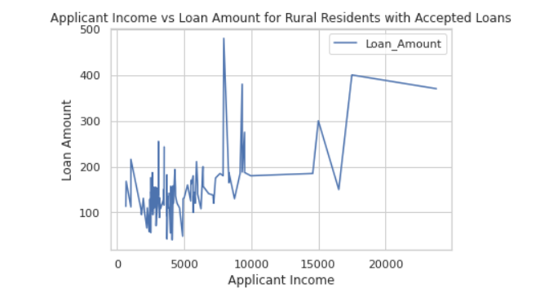
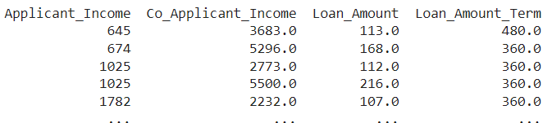
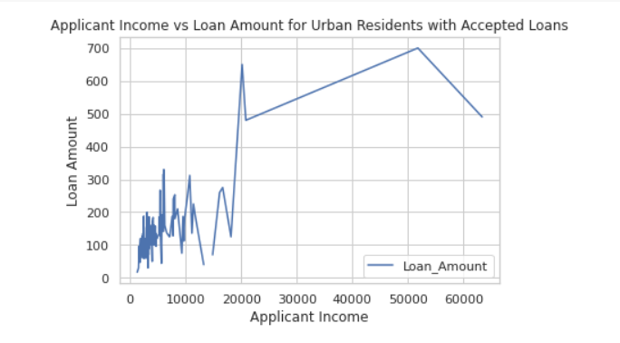
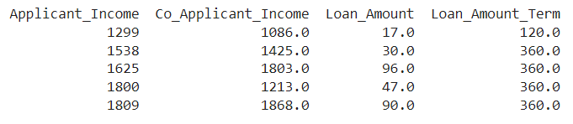
Applicant Income vs Loan Amount for each Residential Area

Slide 15
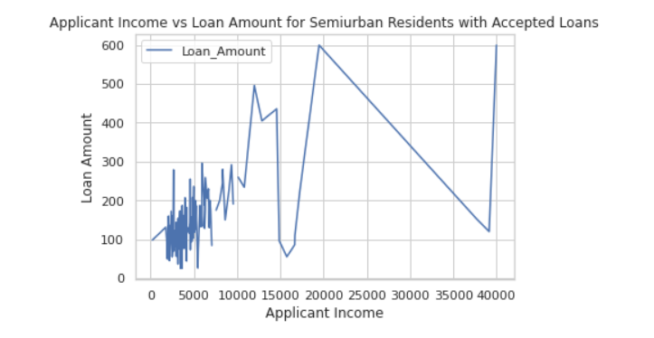
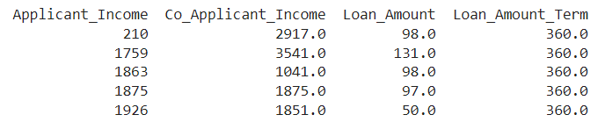
Applicant Income vs Loan Amount for each Residential Area

Slide 16
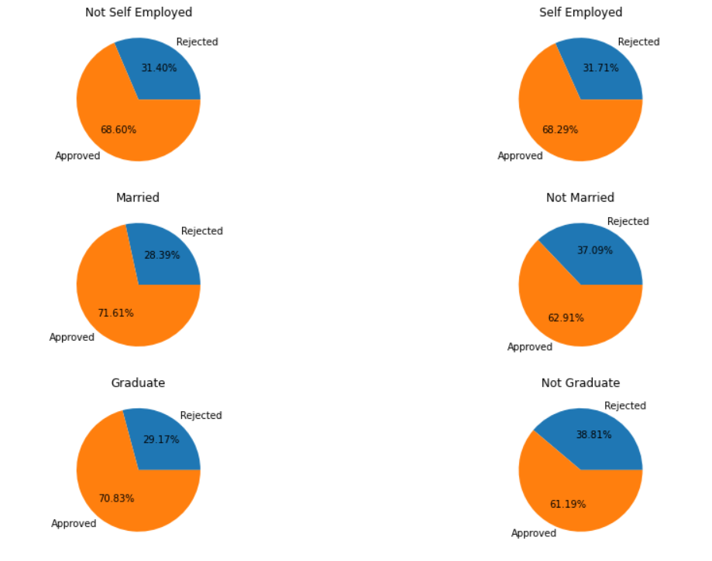
Compare Main Categorical Data with Target
Self Employed or Not, it doesn’t affect the Approval Of Home loan.
Approval difference between Married and Not Married is 8.7%
Approval difference between Graduate and Not Graduate is 9.64%

Slide 17
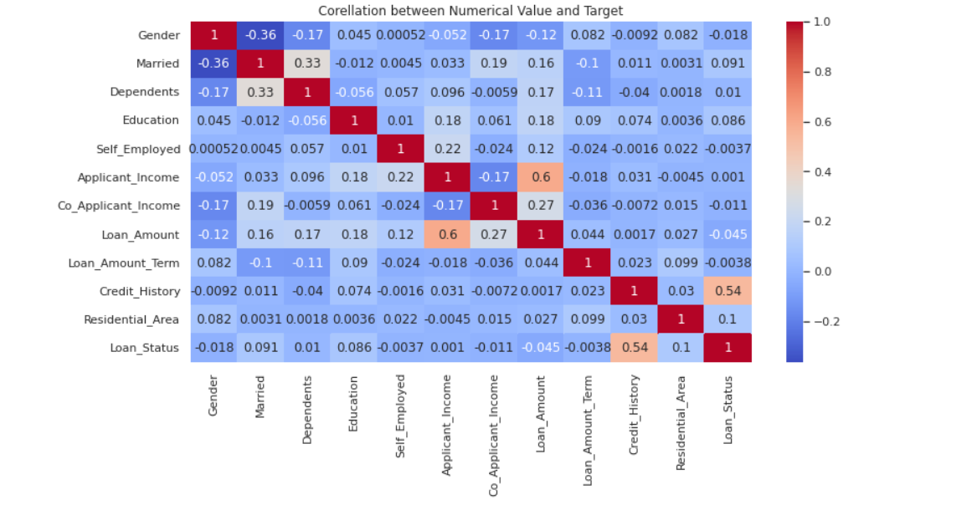
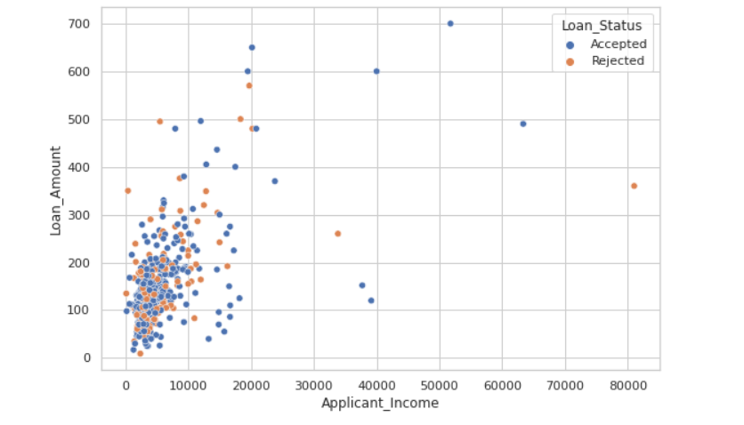
Multivariate Analysis
Applicant Income and Loan Amount (both positive correlated) (0.6) are the features that have the highest correlation with target
Credit History also have high correlated (0.5), but still below 0.6 so we didn’t use it on our model, even have high correlated but we didn’t drop this because the threshold is below (0.8)
Married and Gender is negative correlated with the target but the threshold is below (-0,4) so its okay to keep them.

Slide 18
04
Feature Engineering

Slide 19
Feature Engineering
Categorical Features
1
Categorical feature with 2 distinct values ➔ Binary Encoding
Categorical with 3 feature ➔ Label Encoding
Drop Features
2
Columns ➔ Loan ID
Multicollinearity ➔ No
Imbalanced Data
3
Predict Proba with Precision Recall Curve

Slide 20
04
Modeling and Evaluation

Slide 21
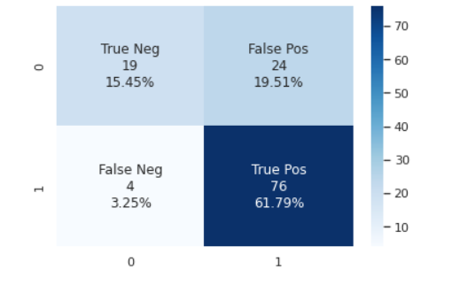
Model | Recall | Precision | F1 Score
Random Forest Classifier | 0.941 | 0.763 | 0.843
Logistic Regression | 0.983 | 0.756 | 0.855
XGB Classifier | 0.958 | 0.741 | 0.836
I split dataset become train and test data with 70:30 proportion. Since tha data is imbalance, I prefer use 3 metrics Recall, Precision and F1-Score
Even the recall is high, but this data lean more on Precision and F1-Score (Recall+Precision),
That’s why we need to tuning this model.

Slide 22
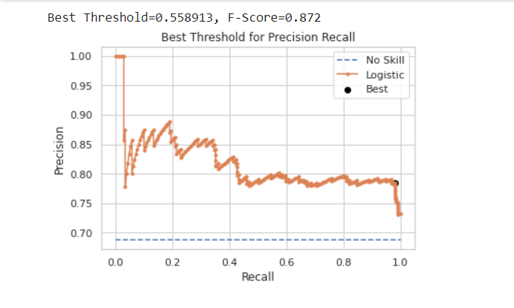
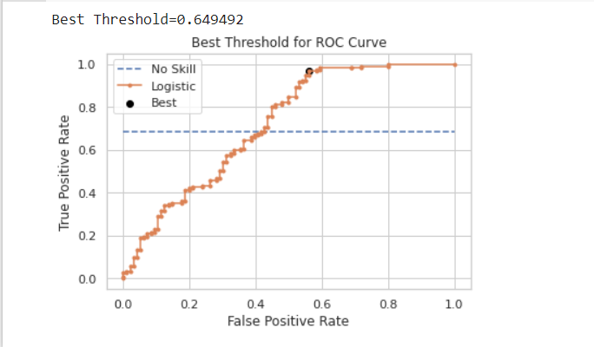
Predict Proba Tuning

Slide 23
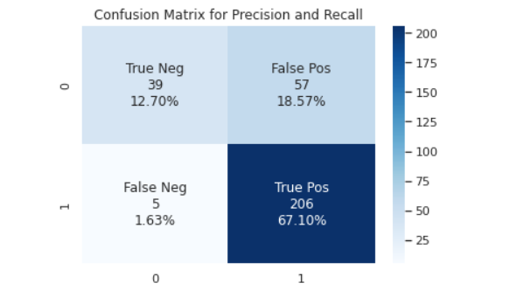
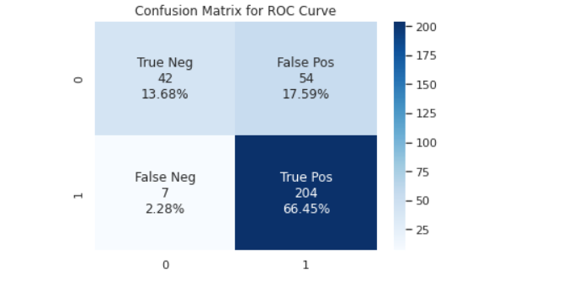
Compare Confusion Matrix for Each Tuning
Precision Recall
ROC Curve
Precision Score for First Matrix is 67.10 / (67.10+18.57) = 0.783
Precision Score for Second matrix is 66.45 / (66.45+17.59) = 0.754
And we choolse First Matrix with better precision score even have higher false positive
After using Predict Proba we get slightly improvement from 61% True Positive into 67.75% True Positive.
False positive also getting decreased from 19.51% to 18.89%.

Slide 24
05
Conclusion and Business Recommendation

Slide 25
Business Recomendation
Our Model have Improvement from base data 68.73% to 78.3%, that’s 10% Improvement
Example Business Recommendation :
Bank AXY have home loan program they want to launch 10.000 Home Loan
Based on our analysis we will focusing to targetting Client that already Married also already Graduated.
Client with Credit History = 0 and Income more than 2140, is good to become our target.
For Segmentation :
Urban Area : we will targeting Client with Income more than or minimum 1300.
Semiurban Area : we will targeting Client with Income more than or minimum 210.
Rural Area : we will targeting Client with Income minimum 645.
Based on our Model we can get 7800 (78%) Client that can be approved, with 6700 (67%) of them can repay the home loan
Based on Heatmap Correlation, Co Applicant have small impact (0.27) in this model, so in this case position of Co Applicant is not secondary to Primary Applicant.
but, if Co Applicant considered to be same as Primary Applicant, we can do some further analysis by adding up income from Primary Client + Co Applicant to form a new Segmentation
Further Analysis can be seen at : https://github.com/syaerulid/Home-Loan-Recommendation

Slide 26
THANK YOU!

Slide 27
Literature review
https://colab.research.google.com/drive/1UPt2hV7d9e4tZH1IJ_h4q2TZkB47bngu#scrollTo=3FVEginp98NM

